Slide 1
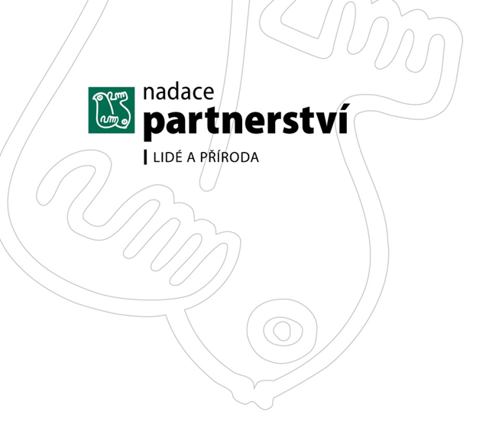

Fundraising best Practices
Cultural Differences?

Slide 2

Pre-Survey | You Said (Your Top 3)
Interest in Various Types of Fundraising Programs
Campaigns 58.6%
Major Donor Programs 58.6%
Online Fundraising 44.8%
Annual Giving 41.4%
Membership Program 41.4%
Special Events 27.6%
Matching Gift Programs 24.1%
Bequests/Planned Gifts 17.2%
Corporate Fundraising 3.4%
Today’s workshop will focus on Types of Fundraising Programs

Slide 3
Pre-Survey | You Said (Your Top 3)
Working with Donors
Identifying New Donor Prospects 72.4%
Working with Corporate Donors 51.7%
Increasing Donor Giving 48.3%
Making The Ask 48.3%
Retaining Existing Donors 37.9%
Donor Communications 31%
Stewarding Donors 20.7%
Cultivating Prospects 20.7%
A separate workshop will cover Best Practices in working with donors. Will take questions today, however.

Slide 4
FUNDRAISING BEST PRACTICES
Today’s workshop format….
Compelling Stats
Fundraising Concepts
Donor Stories
          Quotable Quotes
                Case Studies
SHARE & COMPARE
EXPERIENCES & STORIES

Slide 5

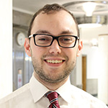
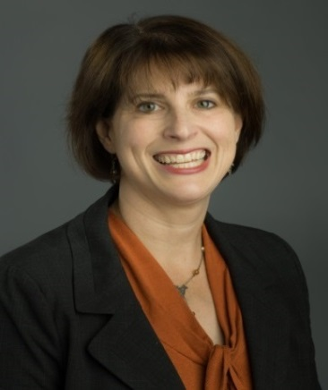
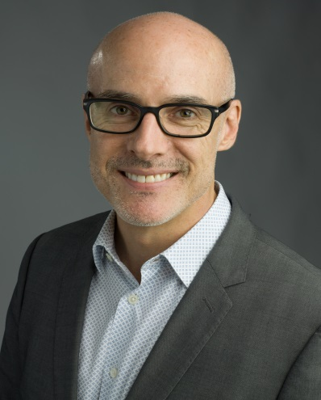
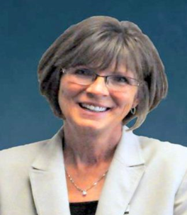
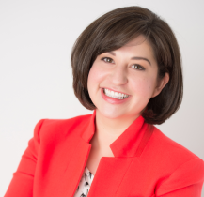
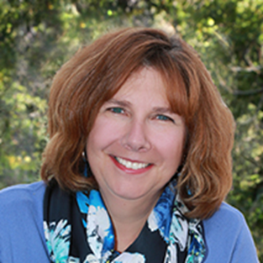
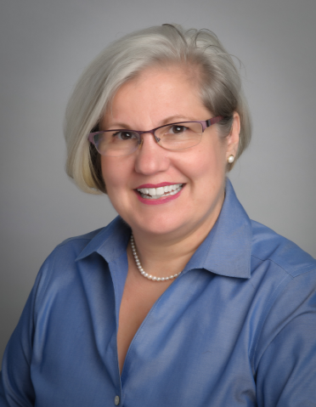
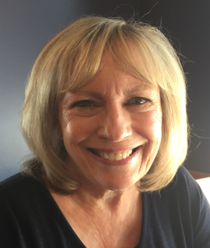
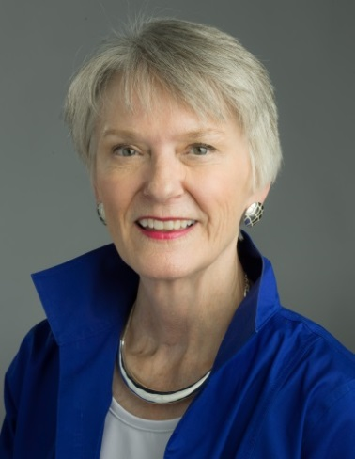
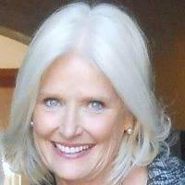
Meet the pros who shared their “know how” with you…
Dwight Clasby
Evann Coadd
Noelle Delage
James Dunn
Jennifer Hopper
Cheryl Kisling
Misa Lobato
Dana Rinderknecht
Susan Swan Smith
PamTerch
Andrea Wagner
Lyn Woods

Slide 6
…and who generously shared experiences from the following organizations
University of Colorado (multiple campuses)
Denver Hospice
The Salvation Army
Tennyson Center for Children
Community College of Denver
Colorado Gives | Community First Foundation
North Texas Giving
Friends of the Pueblo Animal Shelter
Fort Tryon Park Trust, New York
Marymount International School (Rome)
The Lincoln Center, New York
The Anti-Defamation League
The Denver Art Museum

Slide 7

Workshop GOAL
Everyone leaves with ‘just one bright idea’
or ‘seed of an idea’ to consider implementing

Slide 8
First—A quick and important discussion…
“The mutually agreed European General Data Protection Regulation (GDPR), will come into force on May 25, 2018.
It will change how businesses and public sector organizations can handle the information of customers.”
How will the upcoming GDPR impact your organization?
Notes:
Data is a key fundraising resource for third sector organisations - it is how supporters are identified, contacted and often how they are made aware of fundraising campaigns. However, with data comes responsibility for protection of that data. The GDPR will reform the current data laws in the UK as of 25 May 2018 – meaning direct marketing and consent will face significant change and influence how charities raise funds in the future.
So, what do charities need to know?
1. Affirmative consent – the demise of the pre-ticked box
A donor or supporters consent to receive your newsletters, updates and information on your latest campaigns will need to be “affirmative” to be lawful. What does “affirmative” mean? Well, this will include ticking boxes on a website (the opt-in), but reliance on silence, inactivity or the pre-ticked box will be explicitly excluded as means of consent. An early review of how you obtain consent and what information you provide at the time is good practice but will also help you “GDPR prepare”.
2. Rights of supporters and donors
Under the GDPR, your supporters and donors will have the right to:
• “Withdraw consent” at any time, and it must be as easy for them to withdraw it as it was for them to give it - once a participant or donor withdraws consent his or her personal data must be erased and no longer used by the charity; and
• Object to receiving your direct marketing - objection would require you to erase the individuals personal details “without undue delay”.
To avoid fines, consider now how you would ensure that supporters and donors are not contacted once they have withdrawn consent or objected to use of their information.

Slide 9
First….Let’s Talk About what a fundraiser does
How do you see your role?

Slide 10
The All-Important Mindset
Some fundraisers think their job is to ask people for money.
But, it’s not about asking for money.
It’s about…
- presenting an opportunity to have an impact
- giving people a chance to save lives, to change lives, to change the world

Slide 11
You Help Donors Do Great Things
They give through your organization to:
Change lives.
Relieve pain.
Right a wrong.
End injustice.
Add to the world.
Give back.
What do donors get in return?
A feeling—the personal gratification knowing
they did something good.

Slide 12
A donor’s heart isn’t filled with money.
It’s filled with passion.
And that’s what you have to tap into, dear fundraiser.
Think of yourself as a match-maker in the
INSPIRATION business.

Slide 13
Private giving
Just how significant is it?
A few compelling statistics.
Notes:
Today’s workshop primarily focuses on Private Giving.
Before we go further, let me ask you a question. To just make a guess.
Think for a minute about the total amount of giving from all sources. The total pie.
What percentage do you think comes from these main sources?
Take a quick guess…adding your guesses from all sources up to 100%.
Why? Because of its overall significance.

Slide 14
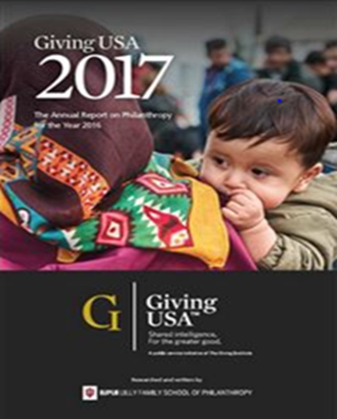
Private Fundraising
Take a quick guess.
What % from each source?
(Of total U.S. giving?)
(excludes public sources)

Slide 15

USA Total Giving 2016 | $390.05 Billion
Sources of Philanthropy

Slide 16
Giving by individuals drove the increase in total giving to an all-time high.
It is, by far, the most important part of giving.
*Giving USA 2017

Slide 17



Who is Giving?
.
Czech Republic
U.S. and UK
Super rich contribute 1/3 of all giving
Remaining 2/3 are donors from medium and low-income brackets
Almost ½ of lowest income donors are pensioners
80% of the total $ of all charitable gifts are made by the richest 5% of the population
Two-thirds of all households contribute to charity

Slide 18

Giving in the Czech Republic
“In general, this country has not reached the same level in number of donors or amounts given as in most west European countries.
Although things are improving, this may be more of a problem of the organizations seeking donations rather than the donors.
…the biggest obstacles for Czech to give [to charity] is that they are not asked enough, and they are not asked well enough.” -Jan Kroupa, Czech Fundraising Center
Do you agree?

Slide 19
Donor BEHAVIOR
What can we learn by studying donors?
.

Slide 20
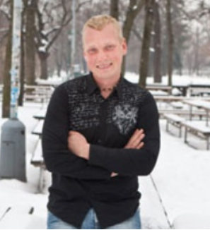
Philanthropy and Young Czech Entrepreneurs
“I made so much money, which I don't need, and the time has come for me to start thinking about others too.”
Is this typical of the growing number of young Czech entrepreneurs?
Are they in fact turning to philanthropy?
Martin Hausenblas
Ústí nad Labem
Notes:
A year ago he would have bought a new car or a luxury holiday in an exotic country. But now Martin Hausenblas has decided to do something different: he will donate 750,000 crowns to charity. "Staying abroad gives young people new perspectives," says the 37-year-old entrepreneur, explaining why he decided to donate the money to a special fund that sponsors young people from the north Bohemian town of Ústí nad Labem to go on foreign study programs.
The 10 percent of his annual income he has promised to the fund should guarantee it a long and beneficial existence. "I want to dedicate my time to this project as well as starting up new ones," says Hausenblas, a young-looking man wearing a pair of plain jeans and a sweatshirt. "Right now I'm planning to build a horse-breeding farm for local children."
"I made so much money, which I don't need, and the time has come for me to start thinking about others too," he adds.
Hausenblas is typical of the growing number of young Czech entrepreneurs who are turning to philanthropy.

Slide 21
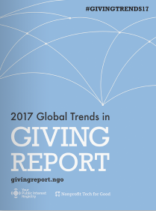
Specific Findings
EUROPEAN Donors
39% of European donors are Gen Xers (1965-1980)
67% are female
70% are ideologically liberal
European Gen Xers give more to…
human and civil rights (23%)
animals and the environment (20%)
international development (19%)…more than any other Gen X donors worldwide.
European donors…
prefer to give online (57%)
most inspired by give by Social Media (29%)
least likely to attend fundraising events (38%) yet find them inspiring
have a low volunteer participation rate relative to other regions (64%)
less inclined to prioritize in-person interaction with favorite NPOs
Notes:
CONTRAST WITH NORTH AMERICA
Donors in North America are unique in that they are predominately women (75%),
ideologically liberal (63%), and Baby Boomers (42%).
Of all donors worldwide, North American donors give the most to the cause of religious
services and faith. 62% prefer to give online which is also the highest rate in the world.
In the United States, the causes most donated to reflect a generational and ideological divide indicative of recent political and social upheaval. Millennials give the most to
support human and civil rights. Baby Boomers are most supportive of religious services and faith. And in the middle is Gen X giving the most to help animals

Slide 22
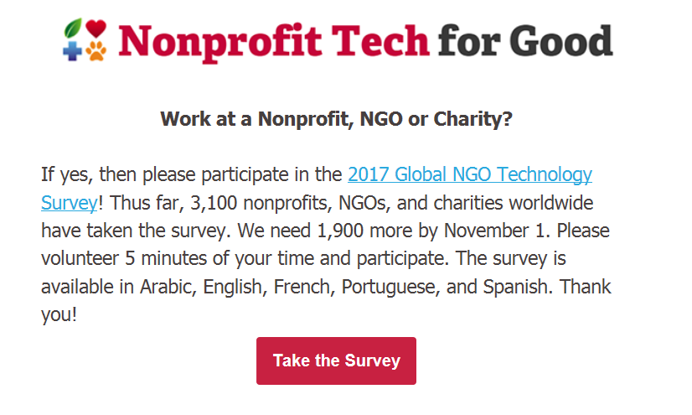
You are invited to take the survey! Only 11 non-profits from CZ have participated thus far.
Notes:
Heather Mansfield, principal, Nonprofit Tech for Good

Slide 23
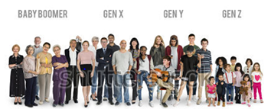
Giving by Generations | The West
Traditionalists (Before 1945)
Generous, many have become today’s major donors as they have aged.
Boomers (1946-64)
Giving less than Traditionalists at the same age. May be because they are less religious.
Gen X (1965-76)
Smaller generation overall by sheer numbers.
Gen Y- Millennials (1977-95)
Less likely to give and tend to give less. Largest generation of all.
Cultural differences?
Younger generations are
passionate about a “cause”—
older generations are loyal to an organization. Giving USA 2017

Slide 24
Donors Give to Many Causes
“Donors have a constellation of passions.”
Donors over 70 Give to average of 11 organizations
Baby Boomers Give to an average of 7 causes
Donors under 50 Give to average of 5 causes
*US Bank, Study of High Net Worth Philanthropy
“90% of donors single out one particular cause
for special support.” —Penelope Burk
“What might this mean to your organization?”

Slide 25
3 Things Donors Say They Need
Prompt, personalized acknowledgment of their gift
Know their gifts have been put to work as intended
Information on results or the impact their gift is having
In other words, they want ongoing,
meaningful information—about their gifts.
Critical to donor retention
Donor Centered Fundraising, Penelope Burk

Slide 26
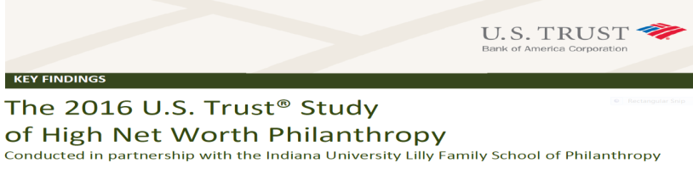
Giving and Volunteering Go Hand-in-Hand
Volunteers tend to give more (private actions)
  Wealthy individuals who volunteer gave 56% more than those who did not volunteer.
  True in Czech Republic?

Slide 27
TYPES OF FUNDRAISING PROGRAMS
Campaigns*
Major Donor Programs*
Online Fundraising*
Annual Giving
Memberships
Special Events
Matching Gift Programs
Bequests
Corporate Fundraising

Slide 28
CAMPAIGNS
What experience have you had?
Best Practices to share?

Slide 29
What is a Campaign?
You may be wondering….
”How is a campaign different than regular fundraising?”
Good Question.
A campaign is a focused fundraising effort.
Specific need or opportunity
Specific monetary goal (usually significant amount)
Raise money by specific time.

Slide 30
Campaign Basics
So now you may be also wondering….
Are there different types of campaigns?
Yes, depending on why you are raising money.
Types of Campaigns Types of Gifts
Endowment - Restricted (specific purpose)
Capital - Unrestricted (no purpose)
Major Gifts
Small-Mid Size Gifts
Annual Fund
Crowdfunding
But the basic campaign concepts and principles
remain the same.

Slide 31
What Our Experts Had to Say
Campaigns
“I’m not a fan of campaigns. People don’t give because you are in a campaign. They could care less. They give to a cause.”
“You have to carefully analyze the reason (the why) behind a campaign. Some initiatives are just not conducive to campaigns.”
“There may be too many campaigns today. Some organizations end a campaign only to start another. We are beginning to see campaign fatigue.”

Slide 32
Four Phases of a Major Campaign
Major Campaigns sometimes take years.
Phase 1
PLANNING
Getting Ready
Phase 2
SILENT
Testing the Waters
Phase 3
PUBLIC
Let the World Know
Phase 4
CLOSING
Celebration
Long ‘to do’ list…
Goals
Priorities
The “Case”
Leadership-Cabinet
Database
Feasibility Study
Leadership Gifts
When 75 -80% of goal has been raised, go public. Let your success breed more success.
Celebrate and Thank All Who Made a Difference
Stewardship begins…

Slide 33
CAMPAIGNS
Feasibility Study
Campaign Chair/Co-Chair
Volunteer Leadership
100% Board Participation
Compelling Vision (Case)
Best Practices
These are the essentials of a successful campaign.
Let’s look at each in more detail.

Slide 34
CAMPAIGNS
Why conduct a feasibility study?
  Assess image of your organization
  Determine if goal and timeline is realistic
  Test the strength of your “case”
  Identify potential major donors and campaign leaders
  Determine the likelihood of success
Side Benefits
  Helps presell the campaign
  Strengthens relationships
Best Practice
Feasibility Study
“If people talk to you about a feasibility study,
they will talk to you about a gift.”
Notes:
Campaigns are big undertakings that challenge an organization. Makes sense to carefully evaluate the likelihood of success before embarking on one.
Can you do without a feasibility study? You could—but they are well worth the time and investment even if you don’t go forward.

Slide 35
CAMPAIGNS
  Top Things to Ask | Feasibility Study
  Experience with organization
  Attributes of board and staff
  Quality of programs and services
  Understand the need and agree that campaign is necessary
  Believe the goal can be reached
  Support you can expect from community
  Recommend individuals to serve as volunteer leaders
  If they are willing to help--in what capacity
  Others who might have the financial capacity for a significant gift
  If they (or their company) will support such a campaign
Best Practice
Feasibility Study
“You are trying to find out if there is sufficient support…”

Slide 36
CAMPAIGNS
“The campaign chair/co-chair must be someone with the right connections and influence.”
“A successful campaign truly takes a village—it is essential to line up the right people to help.”
”You might get lucky to have a famous person lend their name and reputation—but that’s a bonus. “
“We asked every board to make a leadership gift at the outset of the campaign—it was expected.”
“One of the reasons for a feasibility study is to identify others who can help.”
Best Practice
Campaign Leadership
Campaign Chair Co-Chair & Other Volunteer Leadership
“Training volunteer leadership is absolutely critical—they must be inspired and prepared for their role.”

Slide 37
CAMPAIGNS
“Board members will be better at asking potential donors if they give themselves.”
“There must be a very clear up-front understanding of a board member’s fundraising responsibilities.”
“Major donors will ask if board members have given—you can expect this.”
“We asked every board to make a leadership gift at the outset of the campaign—it was expected.”
“We also asked our board members to host house parties or other events.”
Best Practice
100% Board Participation

Slide 38

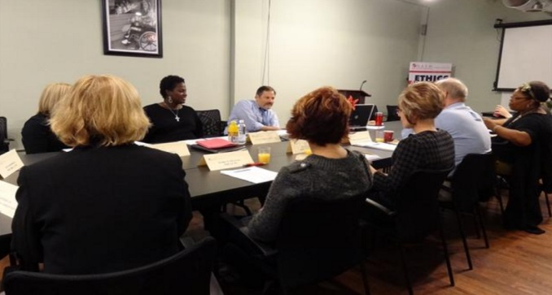
BOARD GIVING
Best Practice
Introduce a “giving” expectation for board members. They should give back because they want to serve the organization.
Everyone on the board should give—period. In the amount of $500-$1000 (minimum) to start.
“Time is not the same as money—you can’t ask people for money if you don’t give yourself. Don’t call it dues—and it is not a bill.”
“Having 100% board participation in board giving sends a strong message to prospective donors.”
Noelle Delage

Slide 39
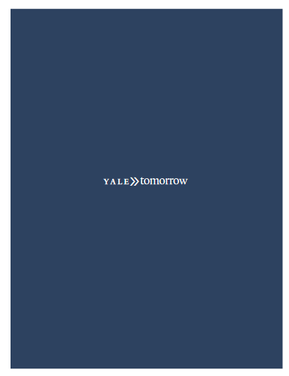
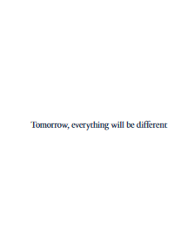

CAMPAIGNS
The Case Statement is Meant To….
Connect donors with an interest.
Enchant. Shock.
Engage donors in a cause they value.
Your case statement needs to put forth a vision and explain in clear terms…
    Why this is worth doing?
    Why us?
    Why now?
    Why you?
Best Practice
Compelling
Vision (The Case)

Slide 40
MAJOR DONOR PROGRAMS
What experience have you had?
Best Practices to share?

Slide 41
What is a Major Gift?
Research has shown that people see themselves as having made a major gift if they donate $500 to $1,000.
Cultural differences?

Slide 42
MAJOR DONOR
PROGRAMS
Active management of individuals thought to have potential by an assigned development officer (or team).
Long and short term strategies developed.
Get to know the donor (passions and interests). Gradually engage them until the time and opportunity is right for an “ask”.
Continue to steward them (other gifts often follow.)
Best Practice
Relationship Strategy
“What happens is that you connect with donors personally.
It is a true relationship.
No matter what happens…it leads elsewhere in life.”
--Lyn Woods

Slide 43
Key Concept | Donor Engagement Cycle
STEWARD
Create Gratifying
Gift Experience
Identify &
Qualify
PROSPECT
Build Trust-Based Relationship
Gain Gift Commitment
DONOR
Match Passion(s) to Organizational Initiatives
Identify Interests and Passions
ASK
CULTIVATE
The second workshop will focus on each step in detail.
Notes:
[NOTE: this slide can be omitted by the facilitator if pressed for time]
The cycle in this slide focuses more on the donor—the donor is at the center.
Note also that it involves building a trust-based relationship. We aim to move donors up a donor commitment continuum (illustrated on the next slide)—from mere awareness of a program, to ownership.
Note that on this and the last slide, we are talking about a continuous cycle—as donors see that their support makes an impact, they become compelled to give again.

Slide 44
Key Concept
Donor Commitment Continuum
Unaware Aware Interest Experience Participation Ownership
Every major gift prospect should be staged along this continuum.
A personalized strategy should be developed
to move the donor to the right
until the time and opportunity is “right” to make the ask.
Notes:
The continuum relates to the donor’s level of engagement and emotional commitment to the organization.
Research suggests that as the level of engagement and commitment increases, so does gift size.

Slide 45
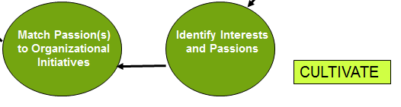
MAJOR DONOR PROGRAM
Best Practice
As you get to know your donor, start thinking about how to match their passions and interests with the needs of your organization.
The “all-important” question to ask your donor or prospect ….
“What would you like to do with your money that would be meaningful to you?”
Then, sit back and listen…

Slide 46
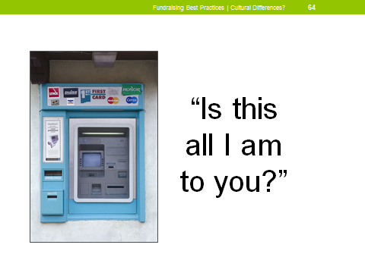
MAJOR DONOR
PROGRAMS
Build Relationships
(it’s not about transactions)
Follow the Donors’ Passions
“Donor Driven…Donor Centric”
Ongoing, meaningful communication (Show them the impact of their gifts—the difference they are making)
Best Practices
Build Strong Relationships
“The relationships I’ve built with my donors are deep and personal and extend beyond our work at the non-profit.”
--Lyn Woods
Notes:
It’s about the difference the donor wants to make---not what you need.

Slide 47
MAJOR DONOR
PROGRAMS
“I find ways for my donors to be actively involved. This usually builds commitment.”
“You need to understand the donor’s interests and values before you ask for a major gift.”
What Our Experts Had to Say
“Two minds are better than one—a team approach can be very valuable in developing a strategy for major donors.”
“Keeping good notes on a donor is critical —especially when there is a long-term strategy and change of staff.”
Part 2 of the workshop will focus on how to work with major donors.
“Scheduled meaningful contacts that move the relationship forward…is key.”
“The gift is not complete until we can honestly say the donor understands the impact they’ve had.”

Slide 48
Key Concept | Donor Engagement Cycle
STEWARD
Create Gratifying
Gift Experience
Identify &
Qualify
PROSPECT
Build Trust-Based Relationship
Gain Gift Commitment
DONOR
Match Passion(s) to Organizational Initiatives
Identify Interests and Passions
ASK
CULTIVATE
The second workshop will focus on each step in detail.
Notes:
[NOTE: this slide can be omitted by the facilitator if pressed for time]
The cycle in this slide focuses more on the donor—the donor is at the center.
Note also that it involves building a trust-based relationship. We aim to move donors up a donor commitment continuum (illustrated on the next slide)—from mere awareness of a program, to ownership.
Note that on this and the last slide, we are talking about a continuous cycle—as donors see that their support makes an impact, they become compelled to give again.

Slide 49
I don’t think you ever stop GIVING.
I really don’t.
I think it’s an ongoing process.
And it’s not just about being able to write a check. It’s being able to touch somebody’s life.
--Oprah Winfrey

Slide 50
ONLINE FUNDRAISING
What experience have you had?
Best Practices to share?

Slide 51
Online Giving
A Small but Growing Piece of the Pie *U.S.
“Only 25% of online giving may be charitable in nature (meaning recognized non-profits)—especially with fast evolving crowdfunding.”
-Pew Research Center
“Though online giving is relatively small today, within the next 5 years things will be massively digital.”
–Network for Good

Slide 52
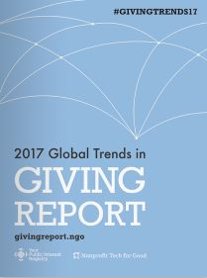
Donors worldwide prefer to give online
Donors worldwide prefer to give online—
true across generations
- 62 % of millennials and
- 59 % of Gen Xers and Baby Boomers prefer online giving.
Of online donors,
42 % cite social media as the tool that most inspires them to give;
And of these donors,
62 % list Facebook as most inspiring channel,
followed by Twitter (15%) then Instagram (10% ).
Websites and email addresses donors trust most?
.org (72 %), .edu (7 %), and .ngo (6 %)
Notes:
Social media is listed by millennials (33 percent) and Gen Xers (28 percent) as the tool that most inspires giving, while Baby Boomers list fundraising events (24 percent) as most inspirational.

Slide 53
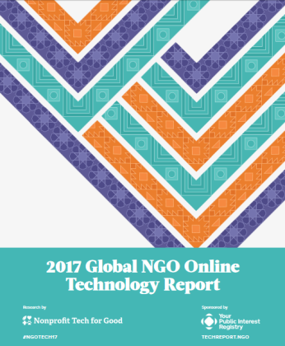
Global NGO Online Technology Report
Key Findings | Europe
98% of NGOs have a website. Of those,76% are
mobile-compatible.
44% regularly publish a blog
74% send regular email updates
61% accept online donations | 50% accept text donations
8% send regular mobile text messages to supporters
Avg # Text Subscribers | Small 2,993 | Med 3,338 | Large 57,500
96% of NGOS in Europe have a Facebook Page
Avg # Likes by NGO Size | Small 5819 | Med NGO 59,674 | Large 146,25
Yet, only 37% of NGOs have a written social media strategy
How do you compare?

Slide 54
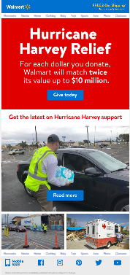
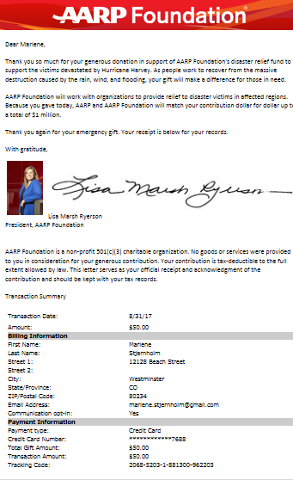
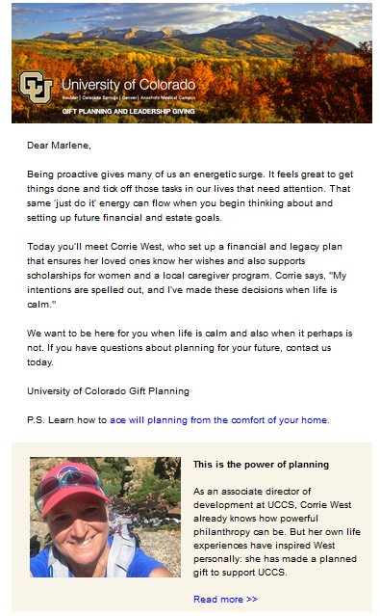
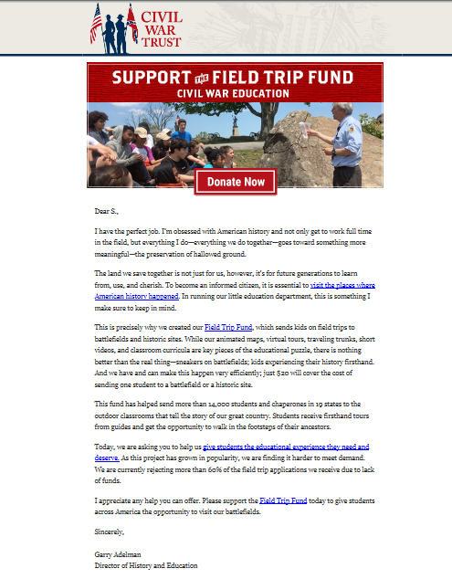
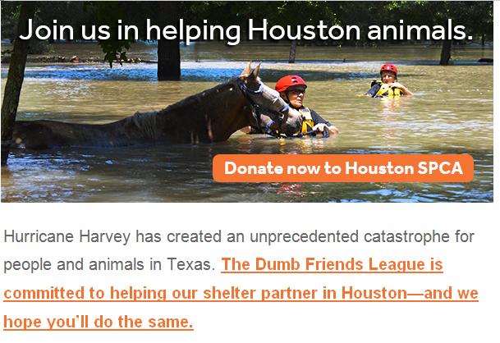
After 20 Years
Email Finally Reaching Potential

Slide 55
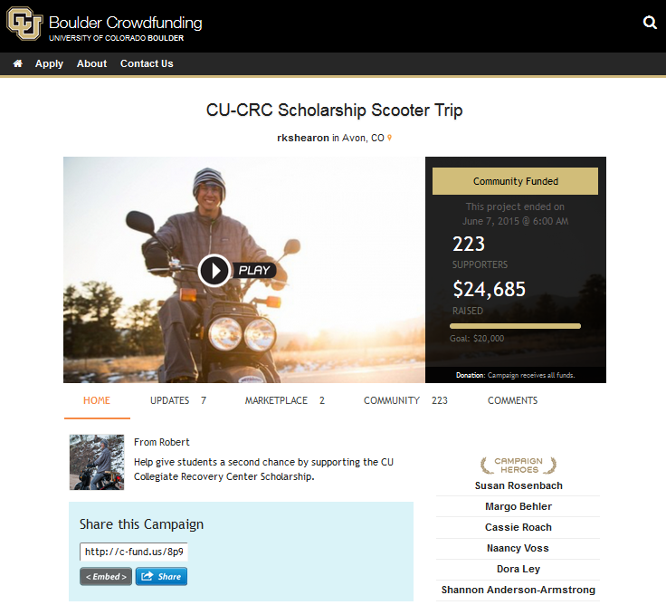
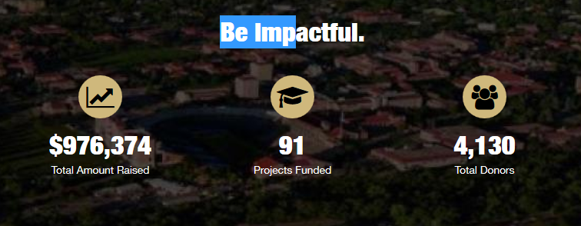
Crowdfunding
Does Your Cause Have Crowd Appeal?
“You will be as successful as the amount of work you put into the campaign.”
—Evann Coad
Crowdfunding is not a "post it and forget it proposition."
Let’s take a peek at a few of CU Boulder’s crowdfunding campaigns.

Slide 56
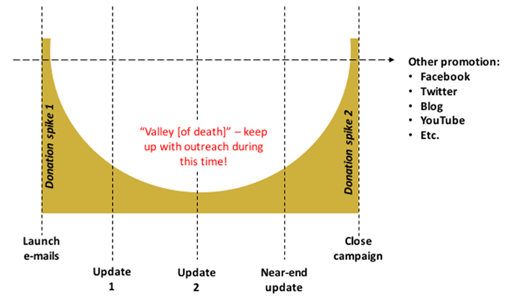
Crowdfunding Campaigns
Expect and Overcome the Valley of Death
The campaign time span is critical. Creates a sense of urgency. A 90 day campaign doesn’t have urgency—but 30 days does.

Slide 57
CROWD
FUNDING
General metric—reach out to 8 people for every $20 you want to raise.
Lead people to your campaign—email works best. (Email 53% conversion; Facebook 12% conversion )
Short videos (less than 3 minutes) most effective
Send updates every 5 days or so
Leverage your own personal network to make first gifts. Others more likely to donate once you have 40% of goal.
Best Practices
Crowdfunding isn’t just ‘set and forget.’ It requires work--boots on the ground.
Evann Coad

Slide 58
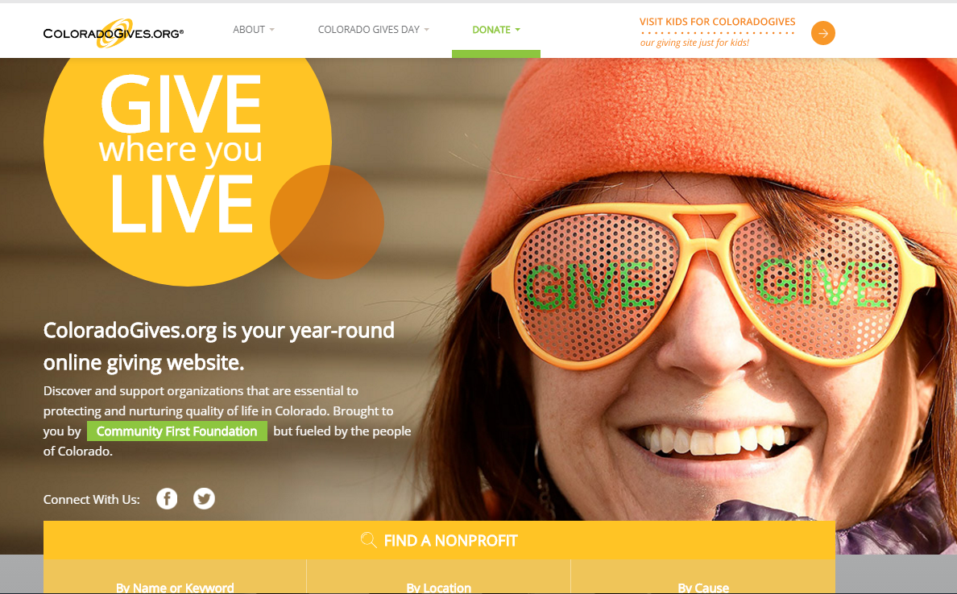
A Case Study in Online Giving –
Colorado Gives
Notes:
Giving website now 10 years old.
Year-round giving. Most other Giving Sites do just the day. Colorado started as year-round giving and moved to the Giving Day.
Colorado Giving is a consolidated giving portal for many nonprofits. Features recurring, monthly giving feature.
Through the site 3200 individuals are giving to 900 organization about $200,000 per month. They are also giving to multiple non-profits. At one point they had a gentlemen who was giving 17 monthly gifts (and he lives in New Jersey, not Colorado).
The website can also be used for Peer to peer challenges—”getting my friends to give to my causes”. Some non-profits tie to an event. It’s a virtual lemonade stand.
Virtual food drive by one non-profit—to raise money, they packaged gifts to impact. For example, $10 buys 3 cases of corn. Involvement device.
E-giving Gift Card—A concept of gift for friends who have everything. It’s more fun for me to give a gift car to let you play around with it. They are promoting using Online Google ads…

Slide 59
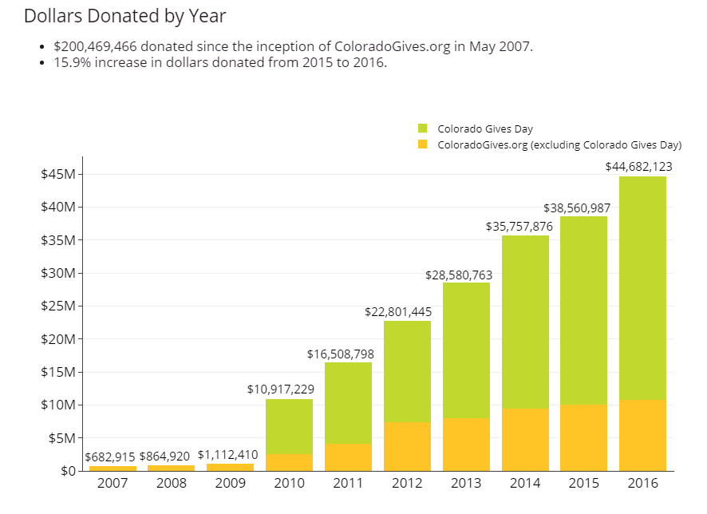
Colorado Gives
Online Giving Success Story

Slide 60
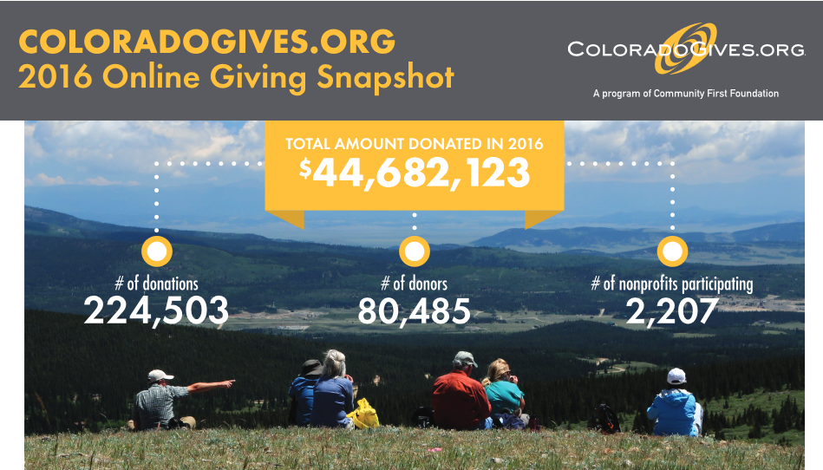
ColoradoGives.org | Full Year Giving

Slide 61
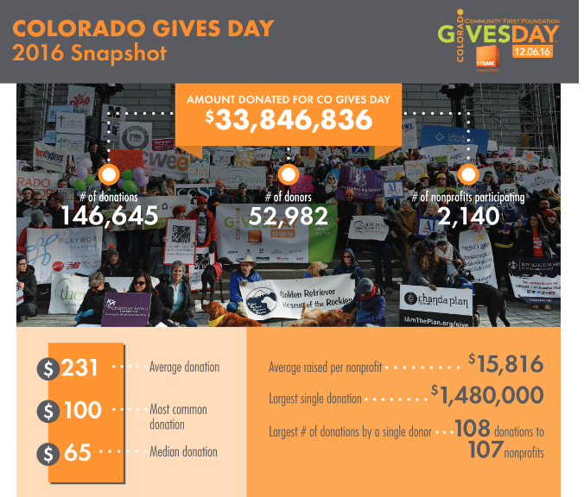
ColoradoGives.org | GIVES DAY

Slide 62
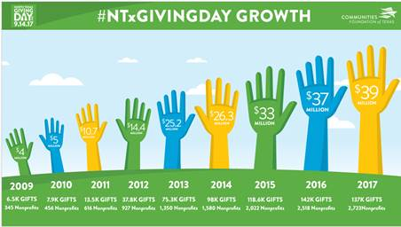
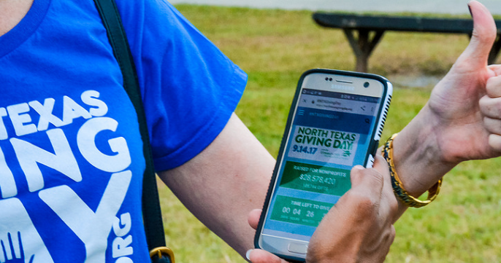
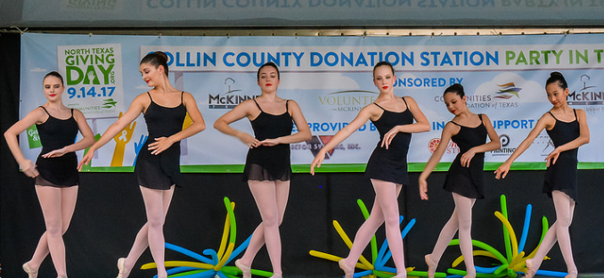
North Texas Giving Day
Texas has a one-day event.
New!
This year…
Donation Stations

Slide 63
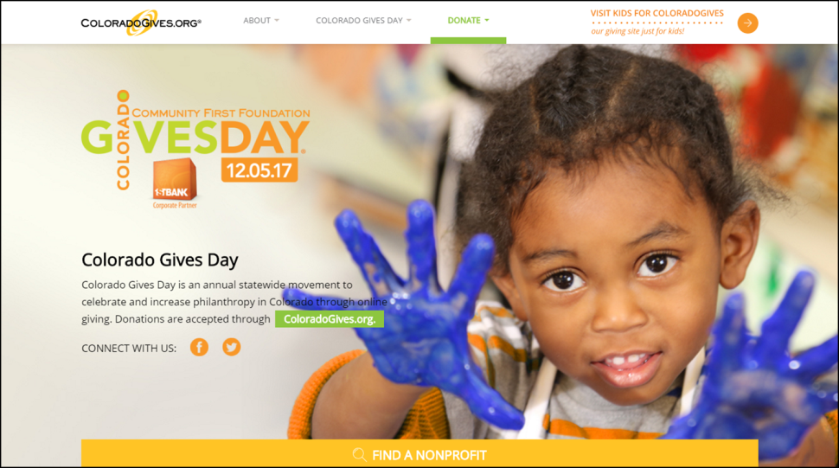
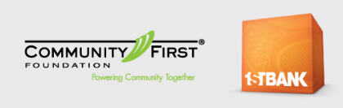
A Case Study in Online Giving
2017 Colorado Giving Day Incentive–
A Staggering $1 Million
The $1 Million Incentive Fund
created by the partners is one
of the largest giving-day
incentive funds in the country.
Proportional distribution…
not a $1 for $1 match.
Big growth expected in
peer to peer fundraising for
Giving Days.
Notes:
Community First Foundation and FirstBank are presenting Colorado Gives Day on Tuesday, December 5, 2017. This annual statewide movement celebrates and increases philanthropy in Colorado through online giving. The $1 Million Incentive Fund created by the partners is one of the largest giving-day incentive funds in the country.
This year’s GIVES DAY ….Tuesday, December 5, 2017
Community First Foundation and FirstBank are presenting Colorado Gives Day on Tuesday, December 5, 2017. This annual statewide movement celebrates and increases philanthropy in Colorado through online giving. The $1 Million Incentive Fund created by the partners is one of the largest giving-day incentive funds in the country.
Matching—too hard to do. For GIVES DAY, there has always been an incentive pool. Changed to incentive pool. It still boosts the total. Right now they get about 4 cents on the dollar.
Biggest gift was $1.4 million—from a trust. She put it in her will. Closing out her will and she wanted to give YMCA.
Gives Day—great way to kick off or end a capital campaign. One of the non-profits got $100,000 gift for capital campaign.

Slide 64
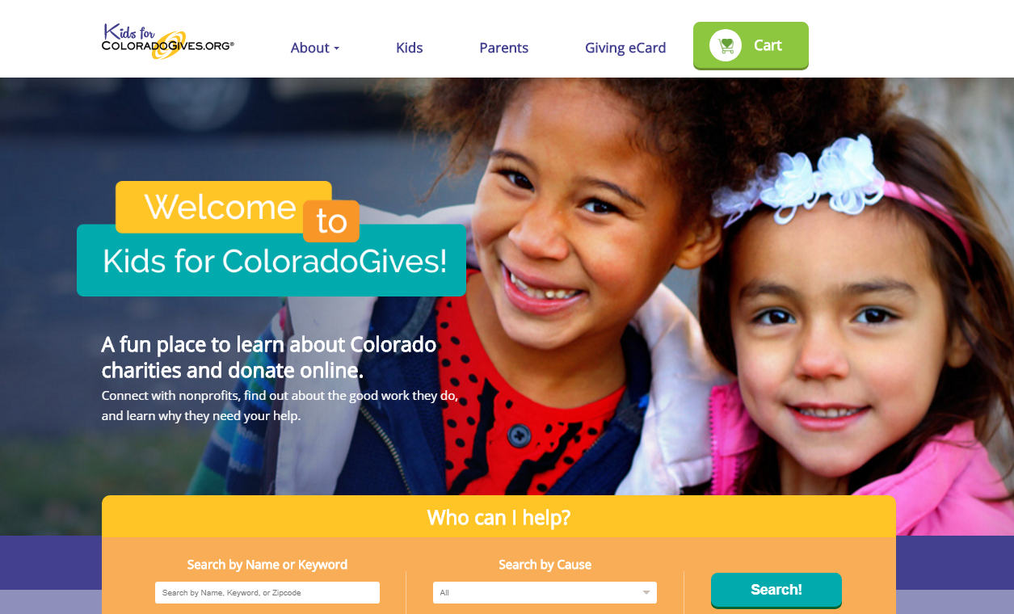
Kids For Colorado Gives New!
Developing the Next Generation of Givers
Notes:
Kids for Colorado Gives…all gift cards.
Heard that people were using GIVES DAY with her grandkids and they pick the non profits they want to give to. Safe and trusted non-profits.
So they created a special site just for kids. Updated the profiles for Kids…specially-designed page. Launched Sept 2016…still very new. Lots of opportunities. Young Americans Bank and Junior Achievement are partners. Also partnering with girl Scouts. They created a special philanthropy badge to encourage kids to go online and give.
Getting kids on the site…Young Americans has another program called Penny Harvest out of new York. Kids collect their pennies…they learn about the nonprofits and grant their pennies at the end of the year. They include some volunteer opportunities for kids too.

Slide 65


A Case Study in Online Giving
Colorado Gives
Donors giving more and to more causes.
  2600 donors gave to 10 or more non-profits.
  Up from 1100 two years ago—a 136% increase
  “It’s easy I can fill my cart.”
    Story of donor who filled their cart online but called to make another gift—this one for $10,000
Bigger gifts are coming in, too
  “Largest gift was $1.4 million to the YMCA—from a bequest/trust. The donor specified in her will that the gift be made online.”
Dana Rinderknecht
Notes:
ColoradoGives
This hugely successful online giving option powers your work and multiplies your good.
Community First Foundation is proud to offer Colorado nonprofits a unique and highly engaging way to increase donations, connect with supporters and spread the word about their mission and work. ColoradoGives.org is our year-round, online giving website featuring the missions, programs and finances of more than 2,000 Colorado nonprofits.
Each organization's online profile is screened by Community First Foundation to ensure specific standards of transparency.
Made possible by Community First Foundation since 2007, ColoradoGives.org encourages charitable giving by providing comprehensive, objective and up-to-date information about Colorado nonprofits and an easy way to support them online. ColoradoGives.org and its signature giving day - Colorado Gives Day - make fundraising simple for your organization and easy for donors. More than $200 million has been raised for Colorado nonprofits through ColoradoGives.org since 2007.
Story about woman who went on line but forgot to give to one of her favorite causes--Lutheran Family Services. Thought called and said that she had “filled my cart” but had another gift to make. She then gave $10,000.

Slide 66

Our Expert Speaks Out
Online Trends
“Text giving in the U.S. is not where it should be even
though some earlier obstacles have been addressed.
You can now get some donor information—and the amounts you can give via text can also be bigger.”
Trends
Text to a number. Get return text with link to donation page on website.
Take a picture of credit card and submit that as payment.
Donor-paid processing fees.
Giving recommendations “You might like these causes…”
eGift cards
Recurring donations (donor retention strategy)
Dana Rinderknecht

Slide 67
ONLINE DONOR RELATIONS
CASE STUDY
Actual Example--Team Rubicon
Hurricane Harvey Response Effort
Step 1: A fabulous receipt
“Your gift empowers our veteran volunteers, by providing them with a sense of purpose, community, and identity through continued services to communities affected by disasters.
Thank you very much for your contribution and for being such a valuable part of the team.”
SWOON
Upgrading a One time online donor into a monthly sustainer in 5 simple steps!

Slide 68
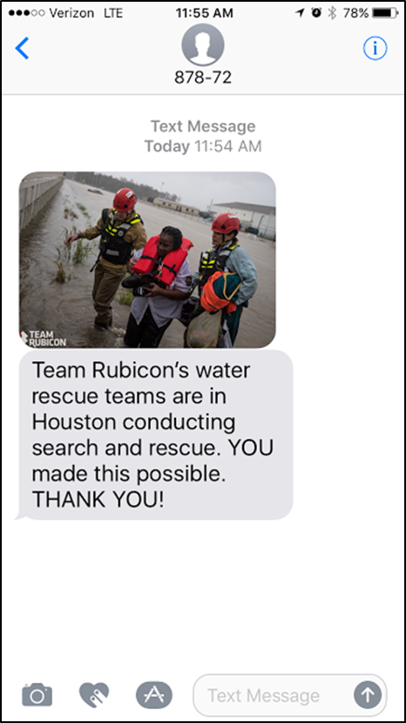
Step 2: Impact in action
WOW- this was sent via text only a day after I donated-

Slide 69
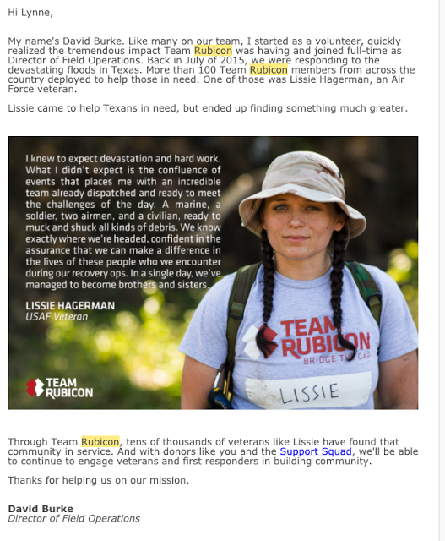
Step 3:
Then a thank you email that was amazing, and honest and relatable- made you feel you really got to know Lissie

Slide 70
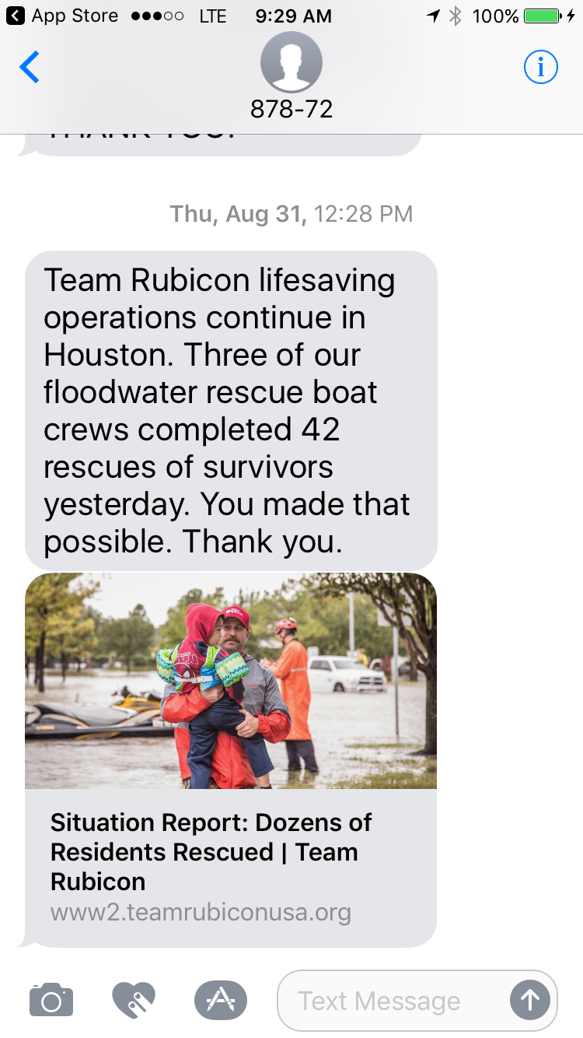
Step 4:
Two days later another impact report text- BAM!

Slide 71
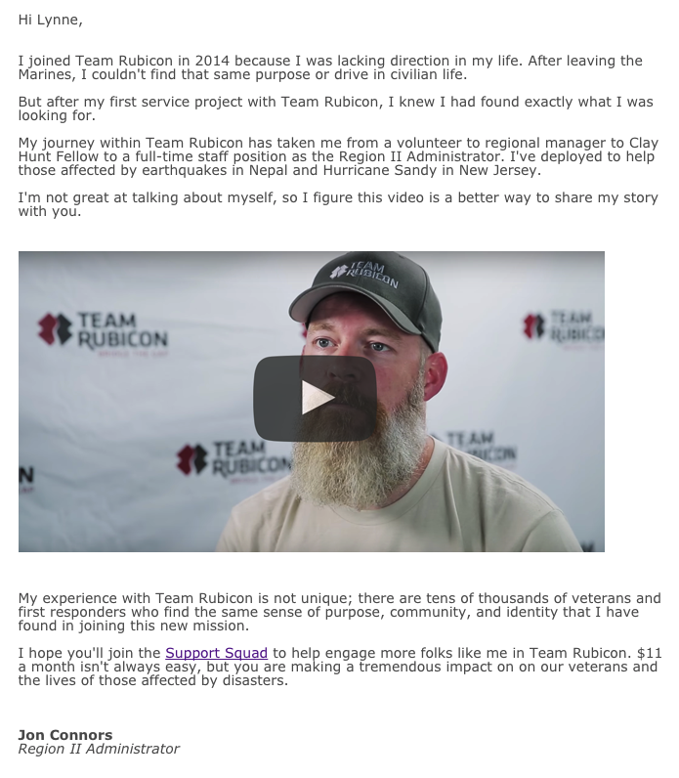
Step 5:
Then Jon Connors showed up in my inbox- and he explained what Rubicon had done for him.
And I was moved.
I knew I had to do more.
And there it was, right there- one click. My opportunity to help was staring me in the face.
Usually I’m not a fan of impact combined with an ask but two weeks and four examples of impact, I felt I was ready.
I gave, I joined their monthly giving program

Slide 72
ANNUAL GIVING
What experience have you had?
Best Practices to share?

Slide 73
Annual Fund
Never overlook your annual fund donors.
Study by Columbia University
Without exception, all of Columbia’s top donors’ ($1+ million) made their first gift to the university within the first few years of graduation---and their gifts were less than $100.
“If you don’t’ have a natural constituency, it’s critical to have an annual fund. You must build a base of support.”
Notes:
Why the annual fund is “the cornerstone” of all fundraising
The annual fund carries this distinction for three reasons:
1. It keeps donors loyal and invested in your work by keeping them informed every year of what the organization has accomplished. In other words, the annual fund keeps your organization “front and center” and reminds donors of all the good work you do.
2. It allows for flexibility. Because the dollars an annual fund raises are unrestricted, those dollars can to be spent wherever they are most needed.
3. It can become an individual’s stepping stone to a higher level of giving. From the annual fund, individuals can progress to becoming “major” gift donors (however your library defines this) and, finally, to planned giving, leaving a gift to your library in their will or estate plan.
Annual fund is a catch-all term for fundraising activities that are designed to stimulate regular giving. It encompasses activities such as telephone campaigns, direct mail, e-appeals, inserts in alumni magazines, adverts and web-based appeals.
These activities are important for many reasons, including that they:
Provide income both for specific projects and unrestricted funds,
Establish giving habits and enable patterns of giving to be tracked,
Establish a donor pipeline, enabling the identification of donors with the potential capacity and propensity to give bigger gifts in the future,
Increase donor participation rates,
Help improve and keep data about prospects up to date,
Are a great stewardship tool,
Help reinforce core messages about an institution,
Help identify the enthusiasts who might be leaders or significant volunteers and
Strengthen the bonds between an institution and its prospects.

Slide 74

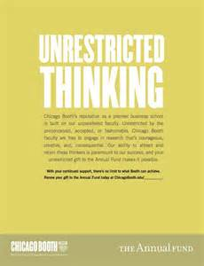
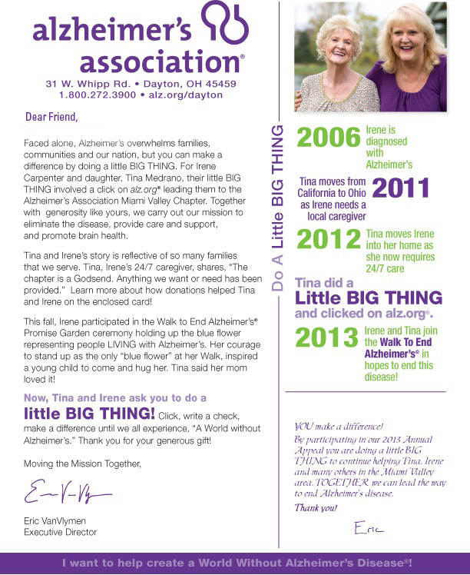
ANNUAL GIVING
An annual campaign establishes regular giving habits in your donors.
In the U.S. most annual fund appeals are during the last few months of the year.
Typically multi-channel:
Direct mail
Email
Social media
Telephone
The most creative fundraisers devise smaller campaigns throughout the year.
These can be more focused both by theme and audience.
Notes:
Many charities mount a signature campaign during the last few months of the year (or before their fiscal year is up). That push is often a themed campaign across multiple channels over a defined period.
Standard methods used for this anchor campaign include direct mail, email appeals, a coordinated social media campaign, and a telephone push to key donors.
Year-end campaigns work well because donors are accustomed to giving at that time of year, and the looming deadline if they want a charitable tax deduction provides added incentive.
Many donors use the end of the year to revisit their giving plans, determine how much they wish to give in total to charity, and add or subtract charities from their list of favorites.
If a nonprofit does not already have an annual fundraising campaign, the year-end general appeal is a must. Most nonprofits start their fundraising in this way, and many have built on that base successfully.
However, the most creative fundraisers go beyond the signature campaign. They devise waves of smaller campaigns throughout the year. These can be more focused both by theme and audience.

Slide 75
What Our Experts Have to Say
Annual Giving
“Consider your annual giving as your pipeline for major donors.”
    “Expect complaints—but for every complaint, you get 10 gifts.”
“The attrition rate is significant—we lose almost the same number of donors that we bring in.” (Remember the ice bucket challenge?)”
    “Gradually increase the ‘ask’ amount—but personalize it to the donor.”
Notes:
The difference between an annual fund and a membership campaign
Many Friends groups and Foundations conduct membership campaigns throughout the year. Membership contributions can be solicited from individuals anytime during the year. Most individuals think of a membership contribution as a fairly small gift; most memberships are in the $10 to $50 range. Most donors who give a membership contribution don’t think very much about that gift constituting a charitable (tax deductible) contribution, but rather view it as a small token that provides an affiliation between the individual and the institution.
An annual fund contribution, however, is made at the end of the year and does feel like a tax deductible contribution to the giver because that is the time of year when people are thinking about doing just that – taking advantage of a last chance to lower their taxes. As a result, people are usually more generous with their annual fund contribution than with their membership contribution; thus, the annual fund has the potential to bring in large amounts of revenue.

Slide 76
ANNUAL GIVING
Creatively package your appeal focusing on your mission (Examples: food for the hungry, camp for kids)
Segmented niche messages (if possible)
Personalize as much as possible
  Personalized “ask” amount (based upon past giving)
  Personalized copy to make as relevant as possible
Multiple-channel communications
Send follow-ups (can take 3+ messages to renew)
Tell donors date and amount of last gift (most think they gave more recently)
Best Practices
“You need to translate operations needs into inspirational opportunities—by packaging them differently.”
— Lyn Woods
Notes:
Operation giving…annual giving….keep the doors open. It’s all about packaging.
Trying to get kids funded to go to camp. Campfire, zip lines, archery…poor kids don’t get to do this. Mail appeal asking for camp gifts. Didn’t get much. They packaged the campaign=== send 6 kids to camp. Buy t-ps’. Raised about $200,000. Scholarships to camp. The gifts all go to the camp….res Dining hall sponsors.
Individuals tend to give from three sources: discretionary or disposable income,
their assets, and estates. The annual fund generally seeks funding from individuals’
discretionary income. This statement does not seek to belittle the practice of sacrificial
giving. People with strong religious belief or those who share a tradition of philanthropy
,
will tend to give sacrificially. For the most part, however, the bulk of contributors will
not make any gift that will compel them to give up something important in their lives
or cause them to change their standard of living. Nevertheless, they continue to give
generously to causes.
Contributors will give for current program support, to meet a special need, for capital
purposes, or to help build the organization’s endowment holdings. This sympathetic
broad-based giving pattern is not haphazard. The interests of the contributor must be
nurtured. Involvement is invited through the annual solicitation of gifts to the annual
fund. The very process of solicitation can encourage the contributor to become more
knowledgeable about the organization, more understanding, and therefore more
supportive

Slide 77
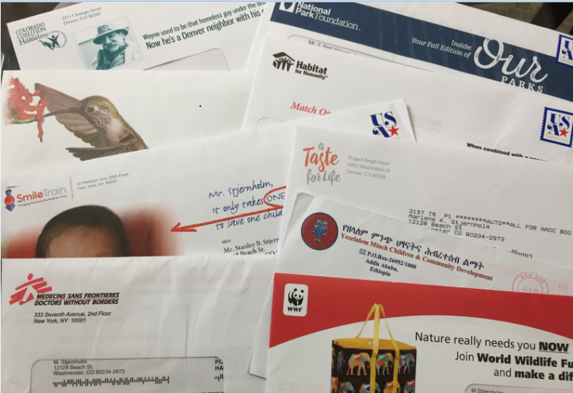
Which do I open? Which do I give to?
Fundraising Appeals | Only 3 Days
Direct mail still valid (though expensive).
1% response respectable
But people are increasingly going online…
to either research the organization or to make their gift.
--Network for Good

Slide 78
MEMBERSHIP PROGRAMs
What experience have you had?
Best Practices to share?

Slide 79

MEMBERSHIP PROGRAMS
A type of annual fund—with benefits
Typically supports general operations
Right for some (not all) organizations
Perceived “added value”
Usually ‘tiers or levels’ of membership
Benefits might include--
  unlimited admission
  ‘first to know’ communications
  member discounts
  member newsletter
  members only events
“Some people want to feel like they are part of something.
A membership program can create a feeling of ‘affinity’ with the organization.”
--Jennifer Hoppa, Fort Tryon Park Trust
Notes:
Alternative to annual giving that creates feeling of belonging
Opportunity for ongoing dialogue with members.
Helps identify prospects for major donors.
Different levels can helps you better understand your donors—provides clues to their capacity.
It’s a value proposition—you are providing something very valuable. You are asking people to invest….people to invest.
If you are afraid of cutting off access---you can support this . Like SCFD says, “Serving the community—people who can afford it will subsidize people who can’t.”

Slide 80
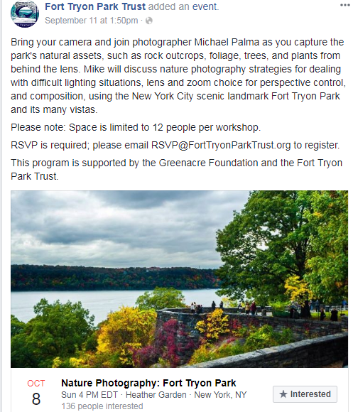

Membership Has Its Benefits
Special merchant discounts
“First to know” about events
Members only events
Branded member gifts
…and more
Notes:
The difference between an annual fund and a membership campaign
Many Friends groups and Foundations conduct membership campaigns throughout the year.
Membership contributions can be solicited from individuals anytime during the year. Most individuals think of a membership contribution as a fairly small gift; most memberships are in the $10 to $50 range.
Most donors who give a membership contribution don’t think very much about that gift constituting a charitable (tax deductible) contribution, but rather view it as a small token that provides an affiliation between the individual and the institution.
An annual fund contribution, however, is made at the end of the year and does feel like a tax deductible contribution to the giver because that is the time of year when people are thinking about doing just that – taking advantage of a last chance to lower their taxes. As a result, people are usually more generous with their annual fund contribution than with their membership contribution; thus, the annual fund has the potential to bring in large amounts of revenue.

Slide 81

MEMBERSHIP PROGRAMS
Structure membership levels around what you believe is close to the giving potential of donors.
Expect giving capacity to vary.
Notes:
You want to attract as many donors as possible to make their respective donations which they may choose from a number of various giving levels you provide in your campaign
Membership levels need to be structured around what you believe is, or close to, the giving potential of your prospective “members.” As you will discover after rating each of them, capacity will vary widely.
Plugging into your campaign a wide range of membership levels allows you to provide each donor a giving opportunity he or she will recognize as appropriate to personal circumstances and the depth of his or her connection to your mission. In addition, the more giving levels you offer, the greater flexibility you will have in securing support at even higher levels as solicitations continue.
Some organizations offer special rates for students or senior citizens.
Odds are, some whom you’ve solicited at higher levels will send donations at those lower levels anyway. Not a good practice to solicit them intentionally. Of course, you’ll welcome any and all donations – – and use the time between membership and renewal to cultivate and engage such members toward upgraded support.
If you’re starting from scratch or seeking to expand an existing but small base of donors, identify new prospects in ways described in the exhibit Major Donors & Prospects—beginning always with your Board of Trustees.

Slide 82
SPECIAL EVENTS
What experience have you had?
Best Practices to share?

Slide 83

Why Hold Special Events
Raise visibility
Engage supporters
Mobilize volunteers
Celebrate achievements
Highlight a particular issue
Kick off a membership or fundraising campaign
Get names!
“The biggest predictor of an event’s success is the quality and energy of the people who work on it…
and the size and dedication of your core supporters.”
“Events are hard—they are time-consuming. They are expensive and don’t always yield the results .” —Noelle Delage

Slide 84
SPECIAL EVENTS
Get clear on your real objective—raise money or other goals?
Aim for a creative event or a new twist on an event—something with PR interest
Over estimate expenses by 20% and underestimate revenues
Honestly evaluate the time and effort required
Recruit the right person to chair the event (and identify the leadership a year ahead)
Close attention to details—create tools and processes for repeating the event
Create corporate sponsorship opportunities
Best Practices
“Many special events are an inefficient way of raising money, bringing in $1.00 for every $1.33 spent on them.”
—Charity Navigator

Slide 85



A Story of Two Galas
One Successful—One Not
The All Out Gala
Jim Dunn
The Scaled Back Event
Lavish event—tickets 150 Euros
Led by well-connected person in the community.
Top hotel venue
Well-known personality as MC
Included a fundraising auction
Simple cocktail reception
Tiered pricing for tickets—from $75 to $1,000—you decide what to pay
Patrons listed in program (by pricing tier)—public recognition of ticket price
Surprising number of people bought tickets at the $1,000 level.
Notes:
Once year they had a gala. An Italian woman, well-connected. Pulled beautiful gala at a top hotel. Had well-known personality who served as the MC. Different demographics—affluent Italians, state department middle class paid for by state dept., then other embassy kids. Big range of economic levels. Pricing the gala tickets was an issue…beautiful event…but the tickets were 150 Euros but made no money at all, even thought they had live auction. Italians loved it because it was lavish. No incomes.
New ambassador in Rome—massive villa in Rome. One shot to have an event there. We needed to use it for fundraising. You could buy a ticket to an event. Priced the tickets as though it was an event in NY—steps of pricing. Just a cocktail reception. They didn’t understand the different benefactor levels at all. Will they spend more than what they have to. Simply a different level of recognition. Just a different way of recognizing the donors in the program. Surprisingly, a large number of people bought at the $1,000 level yet it would have cost $75 to attend. Indication of how the culture can work both ways. Raised a lot of money—cost very little.

Slide 86


SPECIAL EVENTS
Three Ways to Boost Your Special Event
Peer to Peer Fundraising
Tap into your supporters’ networks.
Have them fundraise for you.
“Raise Your Paw” (hand)
Direct appeal to fund specific needs
at a fundraising event.
“We missed you—but you can still help”.
Reach out to non-attendees.
Look for Ways to Leverage the Full Potential of Your Event

Slide 87



Trend Alert
Hosted Small Gatherings
Noelle Delange
Jim Dunn
“You don’t want to get into the entertainment business—so this is where friends and supporters can help.”
Focused, salon-type events in people’s homes.
Smaller, intimate gatherings usually featuring a speaker
At the end of the evening, people asked to give.
“People say ‘yes’ to the invitation because they know the host.”
“The struggle is follow-up..”
“There is always someone who drops
Drops $1,000 or more into the bowl.”

Slide 88


SPECIAL EVENTS
A CASE STUDY
The Mask Project
Denver Hospice
Lyn Woods
Notes:
This year marked the 18th anniversary of the founding of The MASK Project and the 10th year of the gallery and auction. Held biennially, the internationally known fundraiser features hand-painted works from fine artists, musicians, athletes, celebrities, business leaders and more. To date, The MASK Project has raised more than $4.5 million to assist The Denver Hospice to care for all people in metro-Denver.
HISTORY OF THE MASK PROJECT The MASK Project was founded in 1998 by The Denver Hospice and the Cherry Creek Shopping Center. The goal was to capture the imagination of Coloradans with a unique, interactive fundraiser.
And—18 years and 10 exhibitions later—that creative vision is as vibrant as ever.
Over the years, the community event has gained international attention, garnering masks by nationally-renowned artists, celebrities, sports figures, political and community leaders. The highest bid ever received for a mask was in 2006, when Steve Chotin’s mask titled Helpful = Joyful Heart, sold during a festive round of bidding for $141,000. Calls to the live auction came in from Tel Aviv, Australia, Los Angeles and New York as associates of Steve and Robin Chotin and The Chotin Group bid on a mask by Denver artist Charles Wooldridge.
The Mask Project Online Auction, a Benefit for The Denver Hospice
Date/Time
Sep 12, 2016 to Oct 9, 2016
08:00 AM until 12:00 AM
Description

Slide 89




THE MASK PROJECT
A signature event raising over $4.5 million for Denver Hospice.
Held bi-annually.
Celebrity-created masks are auctioned off.
Online bidding, live auction at gala. Masks on display at major shopping center
Notes:
The Mask Project was founded in 1998 to capture the imagination of Coloradans with a unique fundraiser. The unconventional art auction features custom created masks by celebrities, sports figures, politicians, artists, such as Robert Redford, Michelle Obama, Luke Bryant, Bon Jovi, Dale Chihuly, Von Miller, Governor Hickenlooper, Walter Isenberg and many more. Since its inception, the Mask Project has generated upwards of $4.5 million in support for hospice and palliative care for The Denver Hospice. The 500 masks gallery will be available for viewing at the Cherry Creek Shopping Center from September 12 to October 9, 2016. Over 1.5 million people are expected to view the gallery. Artists interested in creating a mask can reach out to The Denver Hospice to obtain a mask kit. The masks will be available for bidding through an on-line auction, at www.themaskproject.org.
The Mask Project Auction will be complemented by The Mask Project Luncheon, which will feature Mitch Albom,bestselling author, awarded sports journalist and philanthropist as the keynote speaker for the luncheon, and which is set to take place on Wednesday, September 28, 2016, at 11:30am, at the Seawell Grand Ballroom (1350 Arapahoe Street, Denver, CO, 80204). Albom is the author of six consecutive number one New York Times bestsellers, including “Tuesdays with Morrie”, the best-selling memoirs of all time. Tickets are $175.
Cost
$75 starting bid
Additional Information
Sponsor
Colorado Homes & Lifestyles, 9NEWS, The Denver Hospice, Cherry Creek Shopping Center
Phone
303-398-6257
Contact name
Sean Goergen
Contact email
sgoergen@care4denver.org
Website
http://www.themaskproject.org

Slide 90

THE MASK PROJECT
Look for extension possibilities…
ways to extend your event to other audiences.
Mask-Making Workshop for Children

Slide 91

THE MASK PROJECT
Everyone wanted in on the event…
Over 400 masks were created and auctioned off.
Even local TV personalities and politicians. got involved.

Slide 92



THE MASK PROJECT
Critical Success Factors…
Creative idea with PR potential
Tested ‘concept’ with mini feasibility study
Leadership (and cadre of volunteers)
3. Celebrity power
4. Hard work and attention to details.
(And maybe some luck)
Lyn Woods
Notes:
If you have a creative idea and then you need a leadership and connection…
Lynn cornered Pete Coors. He said he would do this…asked for $1,000 for a leadership survey.
What happens is that you connect with donors personally, it is a true relationship. No matter what happens…it leads elsewhere in life.

Slide 93
MATCHING Gifts AND CHALLENGE grants
What experience have you had?
Best Practices to share?

Slide 94

MATCHING GIFTS and
CHALLENGE GRANTS
A donor’s gift is matched by a generous donor. Helps people feel their money will make more of a difference.
Various ratios 1:1, 2:1 or more (usually up to cap)
Usually a deadline—creates urgency
The “giver” of the challenge grant is recognized—PR value
Corporations and foundations like to leverage their money
Work out details before you approach the potential donor—ensure that if you fail to meet the goal, you still keep the money raised

Slide 95

EMPLOYEE MATCHING GIFTS
Employee Matching Gifts
Often dollar-for-dollar—sometime double or triple the employee donation
Some match gifts for employees’ volunteer efforts (e.g. walkathons)
Typically, individuals must initiate with their employers
Volunteer Support Programs
Sometimes called “Dollars for Doers” (individual volunteer grants)
Reward employees who donate their time
Team-building efforts (e.g. build a house for Habitat) usually with a corporate donation
Tools to Facilitate Employee Matching Gifts Foundation Directory Online--searchable grant makers
“Every year, only about 1 in 10 eligible donors match their donations.
Every year, about $6 to $10 billion of matched donations is left unclaimed.”
--Double the Donation
Other databases and services make the process easier for donors.
Notes:
Sometimes called “Dollars for Doers” (individual volunteer grants)
can take various forms. Also known as individual volunteer grants, these programs essentially reward employees who take time to donate their time to a nonprofit. For instance, a company might offer a $250 stipend to a nonprofit for every 15 hours that an employee volunteers there.
Some companies will also help groups of employees organize for various nonprofit projects, for example, making calls to fundraise for public television or building a house for Habitat for Humanity. A corporate donation to the nonprofit often accompanies these “team building” efforts.
Tools to Facilitate Employee Matching Gifts
For example, when an employee participates in a walkathon or other type of fundraising event, their employer may match the money they raise through sponsorships or other donations.
To find companies that match their employees’ gifts, use Foundation Directory Online, our searchable grant makers database, selecting a Transaction Type search for "Matching grants." You can subscribe to FDO, or use it for free at our libraries and Funding Information Network partners nationwide.
Companies like Double the Donation or HEP Development also provide databases and services for nonprofits to find matching gift providers and make the process easier for their donors.

Slide 96

MATCHING GIFTS
Invite board members and major donors to make a gift that will become a challenge grant (can be a single donor or a group of donors; you can set maximum for matching)
Help facilitate employee matching gifts from companies
  Revise giving forms so donors can indicate if their company may match donations
  Add text in donor thank you’s about employer matching gifts
  Provide forms for donors to give directly to their companies
  Research which companies typically offer matching gifts—put link to the list on your giving website
Best Practices

Slide 97

MATCHING GIFTS
Agents (employees) vote on causes the company will support that year.
For every “sale” (closed real estate transaction), the real estate firm makes a donation to the charity of the customer’s choice.
A twist on a matching gift concept…
The business makes a charitable gift for closed business.

Slide 98
BEQUESTS | TESTAMENTS
PLANNED GIFTS
What experience have you had?
Best Practices to share?

Slide 99

BEQUESTS
(PLANNED GIFTS)
Compelling U.S. Statistics
33 percent of Americans are willing to consider a bequest gift¹
5.3 percent of Americans over age 50 have included a charity in their will
$35,000 is the value of the average bequest commitment in the U.S.
“Planned Giving is about adding a “0” to the donor’s total giving. If the donor’s giving is $25,000, the planned gift potential is $250,000.
-Kristen Dugdale, Vice President, Gift Planning,
University of Colorado Foundation
“Planned giving may be the answer to the objection: ‘I would like to do more for your institution, but. . .’”-Jeff Comfort, Georgetown University
Planned gifts represent the opportunity to be remembered for something that’s been important in your life.

Slide 100

BEQUESTS
(PLANNED GIFTS)
Profile of a planned giving donor
Age 49 or older
Pattern of loyal giving over a number of years
Demonstrated support for a particular cause
Not necessarily wealthiest of donors
Nearly 40 percent of current planned givers have a history of giving make annual donations of less than $500. - 2012 Stelter Donor Insight Report
We’ve seen donors who had given only $275 over their lifetime, make a $1.5 million bequest. -- CUF Planned Giving Team
There is a clear link between life stories and the charities that bequest donors choose to remember.

Slide 101



BEQUESTS
PLANNED GIFTS
Inspire Donors to Make a Gift in their Wills--
A Long-Term Strategy
Best Practice
Ongoing, inspiring messaging through various channels.
“Many people are able to give significant gifts through their wills—far more than they may be able to give during their lifetimes.”

Slide 102

BEQUESTS
(PLANNED GIFTS)
Include a discussion about bequests when talking with donors—educate them
Develop relationships with lawyers and accountants (referral sources)
Provide legally accepted language that can be included in a will or bequest (will kit)
Encourage donors to make their intentions known (A story here…)
Encourage the donor to also make a current gift so they can see the impact of their gift
Create a special “club” for bequest donors (e.g. Heritage Society, Honor Guard)
Best Practices
“It’s common for people
not to share information
about a gift in their will. Yet there are reasons why they should.”
Yet it’s important that they do.
Notes:
We had one donor whose will was written in a confusing way so that three different faculty members could have controlled
Trying to ensure the person that their wishes will be honored.
Not unusual that people won’t share that information.
Bequest story….Anschutz gift. The way it was written in a will, one of three different faculty members could have controlled the gift. What should have been celebrated became a big fight.
Would encourage them to share intention…ambiguity is cleared up.
Also, encourage the donor their giving program during the lifetime…with a current gift. That way, they can see the impact….see if its doing what you want it to do.
Some donors set up their gift to be an endowment—with their name associated so that their gift continues forever. Typically supports scholarships or certain programs. Can also fund a ‘chair’ at a university.

Slide 103




BEQUESTS (PLANNED GIFTS)
Ongoing Communication Strategy

Slide 104
CORPORATE FUNDRAISING
What experience have you had?
Best Practices to share?

Slide 105
CORPORATE FUNDRAISING
Philanthropy is good business—enables a company to differentiate and boost good will (with its employees, too).
Corporate foundations—philanthropy
Sponsorships
Cause-related marketing
Matching gifts/challenge grants
In-kind donations or pro bono services
Finding the right corporation partner is like finding the right life partner. Look for one that matches your organization’s interests, priorities and mission.
Realistic Expectations
In the U.S. only 5% of all giving comes from corporations.
Remember that giving is an exchange—something for something. This especially holds true with businesses.

Slide 106
CORPORATE FUNDRAISING
Discover where the CEO’s heart lies
Focus group of corporate representatives
Leverage connections of your board
Do your research before you set up a meeting with a company
  What the company is interested in
  Giving track record
  Be clear in how you can help the company in an area important to it
  A couple of quick stories---
  University of Colorado Denver, Business Program.
Best Practices
Companies give for different reasons—both altruistic and practical.
“Some businesses value having access to other corporation and foundation donors, as well as conversations with your leadership about subjects important to them.”

Slide 107


Two Quick Stories
Major Multi Million $ Gifts from Corporations

Slide 108

Best Practice
Corporate Advisory Board
CORPORATE FUNDRAISING
  “We developed a corporate Advisory Board
  And invited the up and coming leaders of companies to be members. Not the CEOs
  or big hitters, but the next generation of leadership.
  They turned out to be a great board to
  work with and became real advocates
  for us. We also instituted a giving
  commitment of $15,000 year.
  The board met a number of times per year.
  They provided advice and opened doors
  for sponsorship. The board is still going.”
  The Lincoln Center, New York
Jim Dunn

Slide 109

More On Corporate Giving
“Even though the money is coming from the corporation, try to connect with a senior person in the company and get them involved with their passions.”
“View businesses as a another relationship to be built. Look for existing contacts between staff and volunteers and the company’s employees.”
“Companies tend to want more straight forward things. You need to be very clear with corporations.”
“Ask yourself—what’s in it for the company? Focus on ways to create a win-win partnership.”
“Most businesses prefer to give locally. Your top prospects will be companies operating in your area.”
“Chances are, you are one of many who are applying”
“Best not to count on companies for long-term funding for your organization.”
Random Thoughts on Corporate Giving
Andrea Wagner
Notes:
Pinnacle, JP Morgan, Co-Bank—all gifts were the result of developing relationships with three key individuals.
Funded the university’s Commodities Center, and
Risk Management Insurance Program.
They were interested in academic programs that would support and help change the way they are doing business. Clear outline of what type of services they are wanting.

Slide 110

FUNDRAISING PROGRAMS
One Parting Thought…
“Get really focused on what you are trying to accomplished and then focus on that.
If you can’t do everything, choose one or two areas and move forward from there.”
What will be your focus?
Andrea Wagner

Slide 111
QUESTIONS?
HOW WOULD YOU SUMMARIZE TODAY’S WORKSHOP?

Slide 112
REMBER OUR
Workshop GOAL
What is your ‘one bright idea’
or ‘seed of an idea’ that might work in
your organization?

